Slide 1
Project Adventure
By The Pirate’s Cove

Slide 2
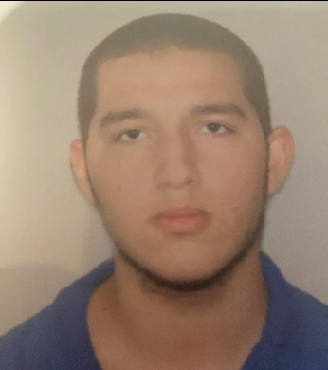
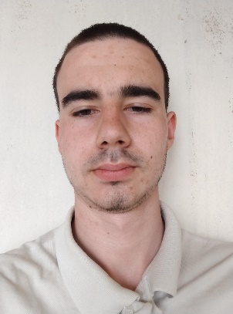
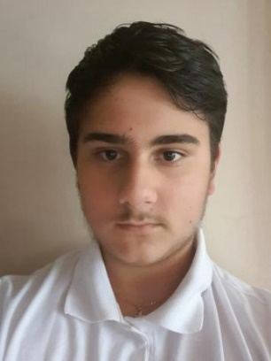
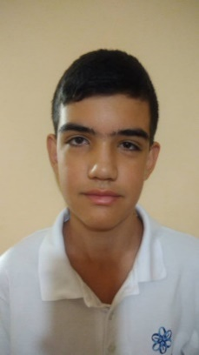
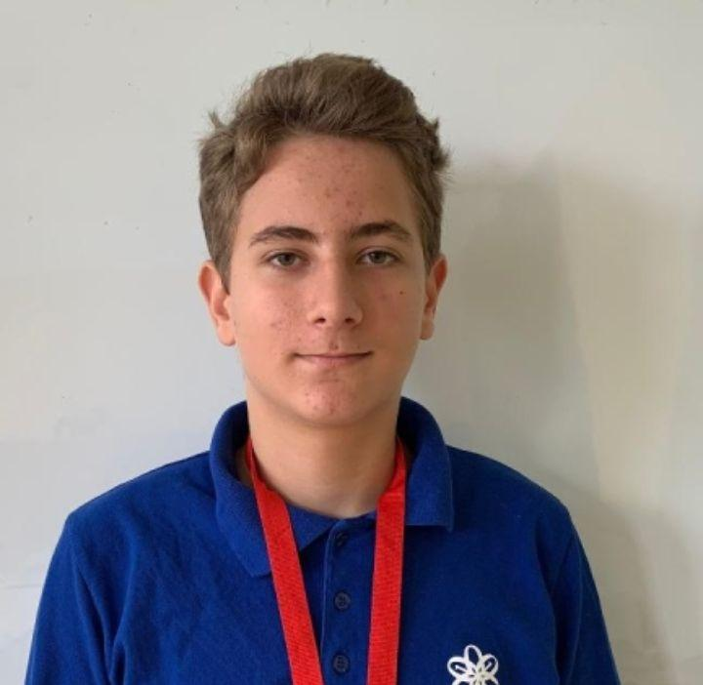
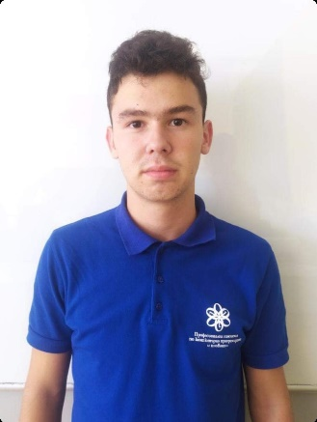
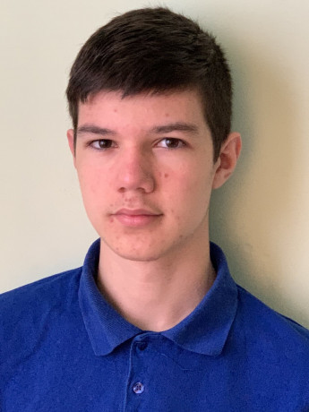
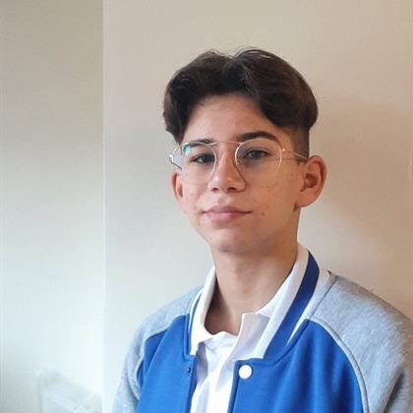
Our Team
Lubomir Bozukov – Scrum Trainer
Georgi Mateev – Scrum Trainer
Bozhidar Boyadzhiev – Back-End Dev
Georgi Zhekov – Back-End Dev
Ivan Dochev – Front-End Dev
Kaloyan Georgiev – Front-End Dev
Mario Zlatev – Back-End Dev
Martin Stoyanov – Front-End Dev

Slide 3






Technologies we used

Slide 4



Stages of realization
1st stage - Planning
2nd stage - Realization
3rd stage - Presentation

Slide 5
Repository

Slide 6
Demonstration

Slide 7
Thank you for your attention!

